Slide 1

Robotics
Coding
Circuit Design
Games and Apps Development
Data Stories
Coding
…Nurturing STEM Skills for the future
www.brainiacs.com.ng
Learn, Play, Innovate

Slide 2

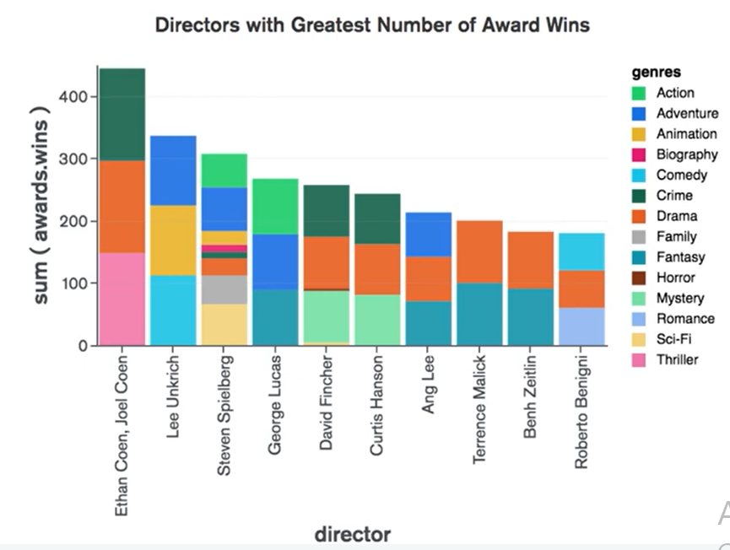
Wow Factor
www.brainiacs.com.ng
Learn, Play, Innovate

Slide 3

Key Skills
Computational
Critical thinking
Creativity
Programming
Problem Solving
www.brainiacs.com.ng
Learn, Play, Innovate
Notes:
Computational thinking
Problem solving
Collaborative skills.
Creative thinking.
Digital Communication

Slide 4
Learning Objectives
At the end of the lesson, the learners should be able to:
Understand data story telling
Understand univariant and bivariant data visualization
To carry out different visualization
www.brainiacs.com.ng
Learn, Play, Innovate

Slide 5
What will you need
A pc/laptop.
Anaconda/jupyter notebook
www.brainiacs.com.ng
Learn, Play, Innovate

Slide 6
Data Storytelling
A data story is created with the intent to explain the data and why it matters. A data story is created to promote change or convince people to take action.
Data stories can be created in different method:
Infographics
Social Media
Blogs
Interactive quizzes
www.brainiacs.com.ng
Learn, Play, Innovate

Slide 7
Data Storytelling
Data is important but can be difficult to understand. A data story teller helps pass on the importance story that the data tells.
A data storyteller helps pass on the importance of the story that the data tells
Data can help influence how people perceive a topic and promote action
www.brainiacs.com.ng
Learn, Play, Innovate

Slide 8
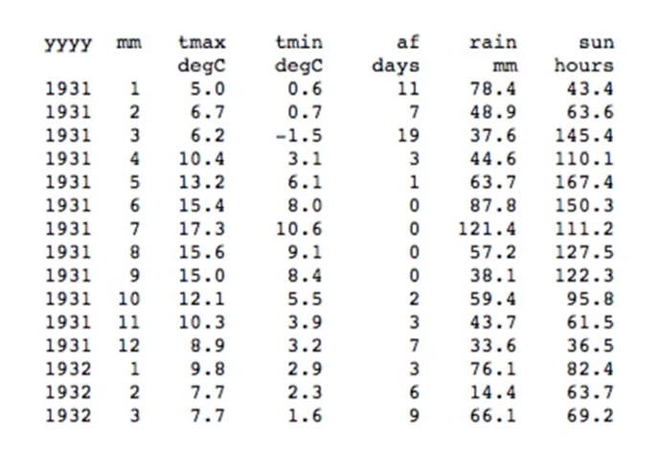
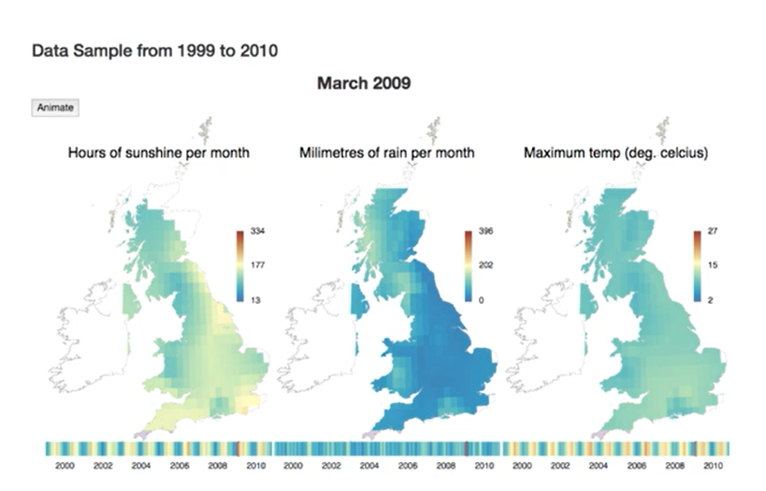
Data Visualization
Data Visualization involves using charts, graphs or images to visualize data.
It is easier to understand data and extract information when it is in visual for,
Raw Data
Visualized Data
www.brainiacs.com.ng
Learn, Play, Innovate

Slide 9
Types of Data Visualization
Data Visualization can be categorized under Univariant or Bivariant data
Boxplot
Histogram
Pie Chart
Scatter plot
Line Chart
Bar Chart
www.brainiacs.com.ng
Learn, Play, Innovate
Notes:
We will explore the type of visualization that falls under univariant and bivariant data in next slides

Slide 10
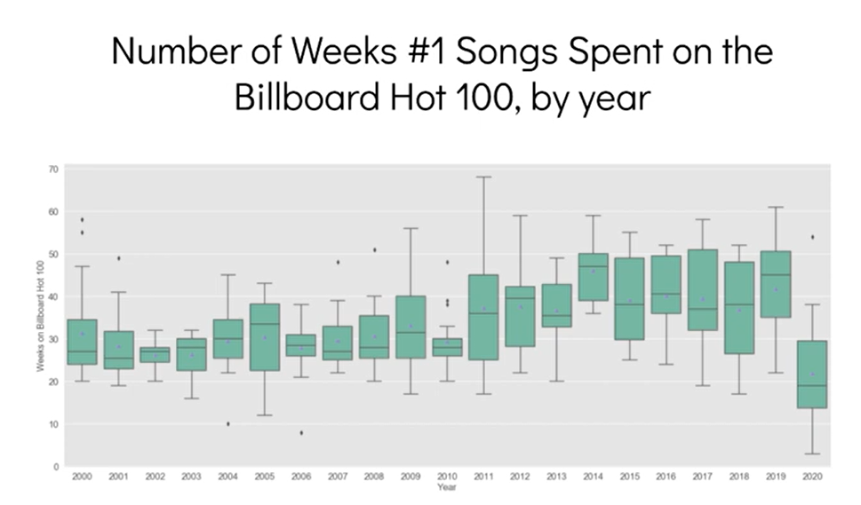
Boxplot
Boxplots are graphs that tell you how your data’s values are spread out.
It is a standardized way of displaying the distribution of data based on a five number summary (“minimum”, first quartile [Q1], median, third quartile [Q3] and “maximum” )
Example:
In which year did the top songs remain on the billboard hot 100 list for the shortest period of time?
www.brainiacs.com.ng
Learn, Play, Innovate

Slide 11
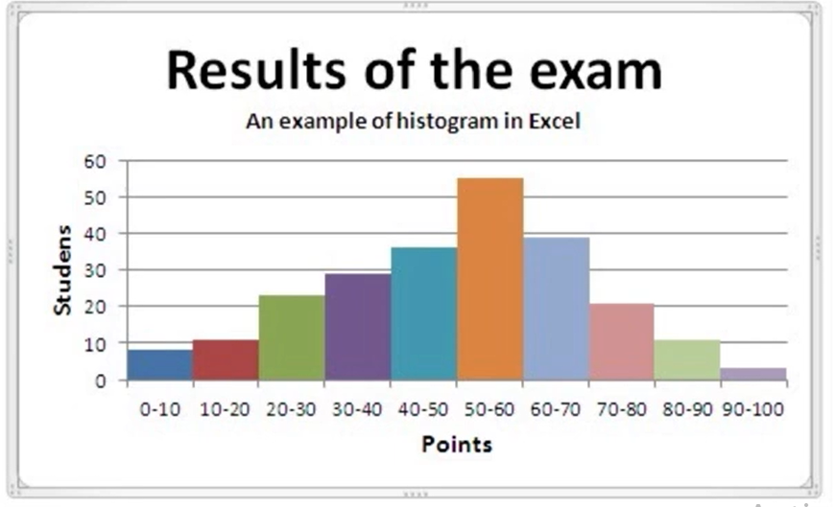
Histogram
Histogram is way to view the frequency of items It can easily spot outliers and values that appeared more than once.
Which score range had the most students? Which score range had the least?
www.brainiacs.com.ng
Learn, Play, Innovate

Slide 12
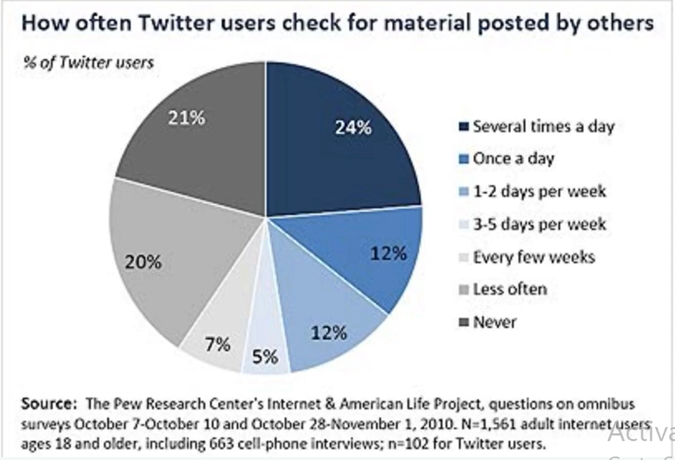
Pie Chart
Pie Chart is a good choice when a percentage is used for interpreting data
What percentage of Twitter users check at least once a day?
www.brainiacs.com.ng
Learn, Play, Innovate

Slide 13
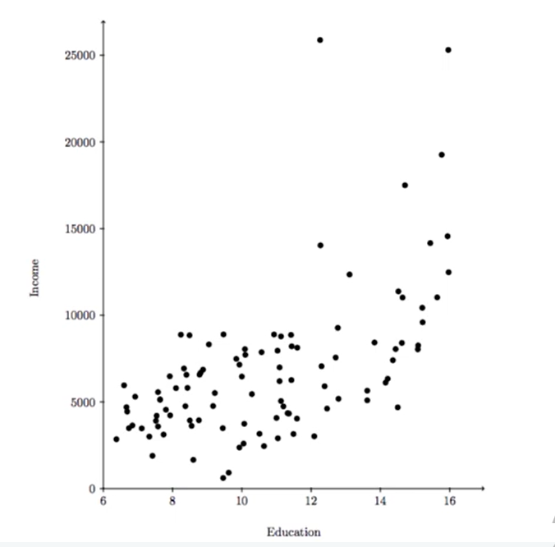
Scatterplot
In scatterplot, every point is plotted to find possible pattern and trends.
Does income seem to increase or decrease based on the years of education a person has?
www.brainiacs.com.ng
Learn, Play, Innovate

Slide 14
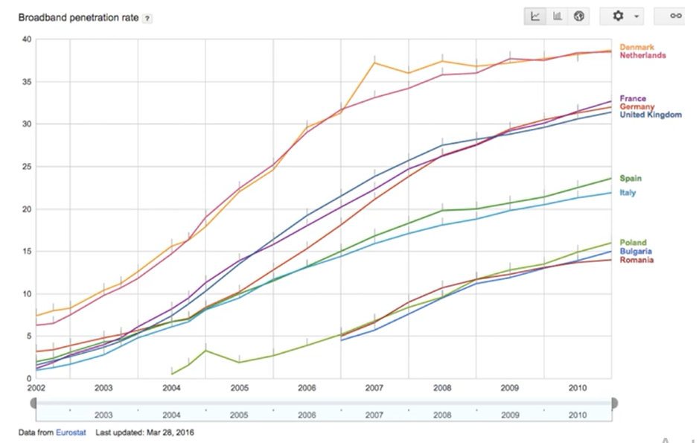
Line Chart
Line chart is best for showing trends
Has access to high speed internet gotten or worse for these countries over the last 10 years?
www.brainiacs.com.ng
Learn, Play, Innovate

Slide 15
Bar Chart
Bar chart is great for comparing different categories
www.brainiacs.com.ng
Learn, Play, Innovate

Slide 16
Univariant and Bivariant Data
Univariate Analysis is a type of data visualization where we visualize only a single variable at a time. Univariate Analysis helps us to analyze the distribution of the variable present in the data so that we can perform further analysis
While
Univariate Analysis is a type of data visualization where we visualize only a single variable at a time. Univariate Analysis helps us to analyze the distribution of the variable present in the data so that we can perform further analysis
www.brainiacs.com.ng
Learn, Play, Innovate

Slide 17
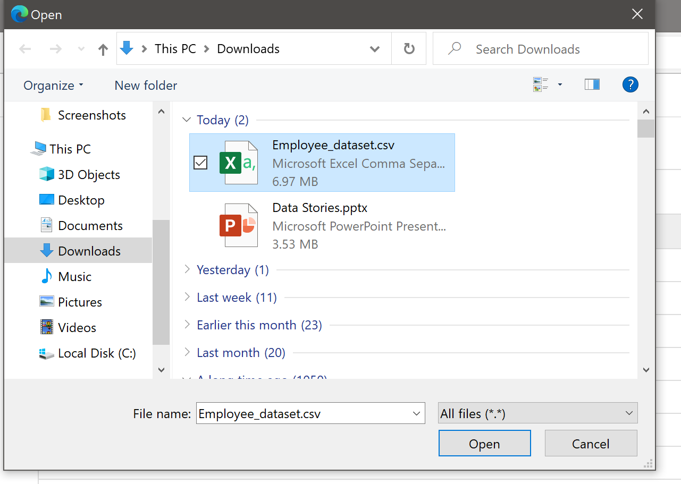
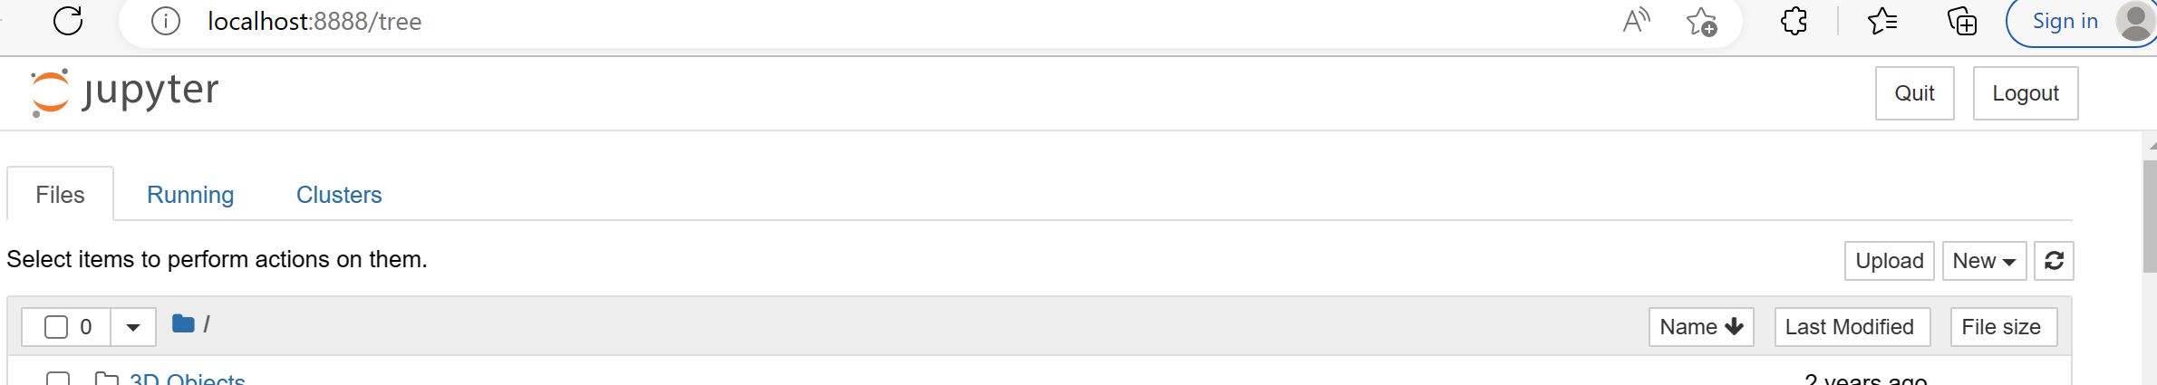
Data Visualization
To visualize our data we will be working with jupyter notebook.
Click here to download the dataset:
https://drive.google.com/file/d/19XxrtuwQCMWoCYV1_h_7fGLoSgmoLh1V/view?usp=share_link
First we will upload the data into our jupyter notenook
(1) Click on Upload
(2) Select the chirping data and click on open
www.brainiacs.com.ng
Learn, Play, Innovate
Notes:
You can copy the link to your browser

Slide 18
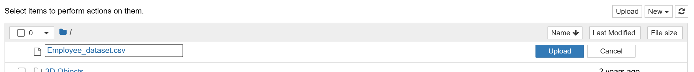
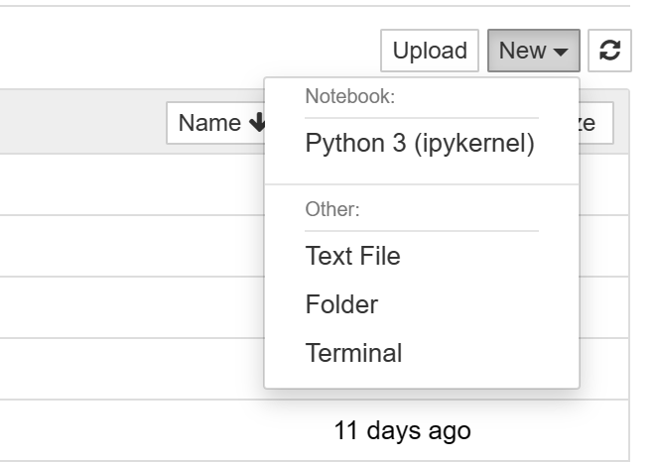
Data Visualization
(3) Click on Upload
(4) Click on new then select Python3
www.brainiacs.com.ng
Learn, Play, Innovate

Slide 19
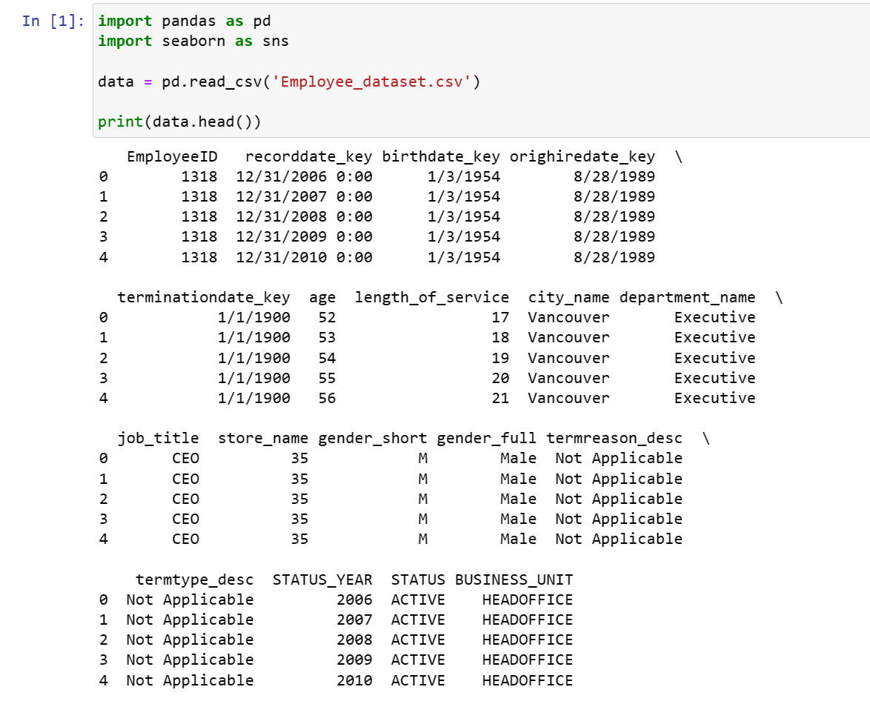
Univariant Data Visualization
Let’s import the data to be visualized
Type and run to import the employee data, and to view the first 5 rows of the data
www.brainiacs.com.ng
Learn, Play, Innovate
Notes:
Head() he

Slide 20
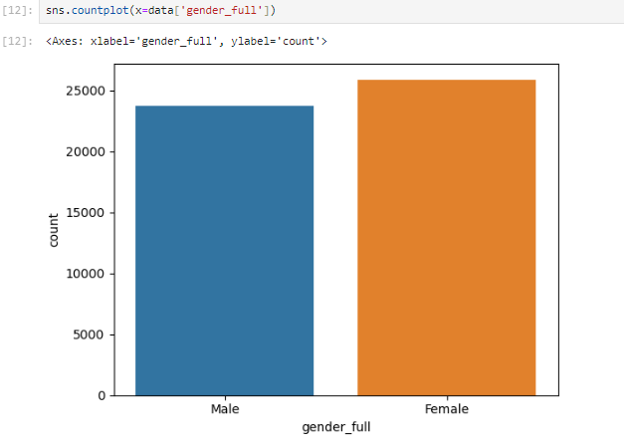
Univariant Data Visualization
Univariate analysis of categorical data. We’ll be using the count plot function from the seaborn library
Type and run to view the count of each category present in the business travel column
www.brainiacs.com.ng
Learn, Play, Innovate

Slide 21
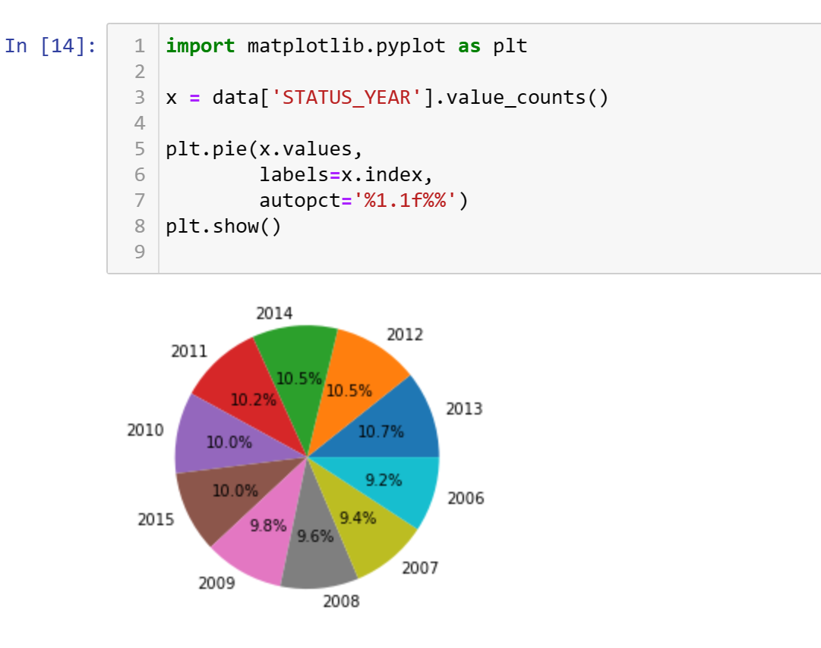
Univariant Data Visualization
A pie chart helps us to visualize the percentage of the data belonging to each category.
Type and run to view the percentage of each status year
www.brainiacs.com.ng
Learn, Play, Innovate

Slide 22
Univariant Data Visualization
A pie chart helps us to visualize the percentage of the data belonging to each category.
Type and run to view the percentage of each status year
www.brainiacs.com.ng
Learn, Play, Innovate

Slide 23
Bivariate Data Visualization
Bivariate analysis is the simultaneous analysis of two variables. It explores the concept of the relationship between two variable whether there exists an association and the strength of this association or whether there are differences between two variables and the significance of these differences.
The main three types we will see here are:
Categorical v/s Numerical
Numerical V/s Numerical
Categorical V/s Categorical data
www.brainiacs.com.ng
Learn, Play, Innovate

Slide 24
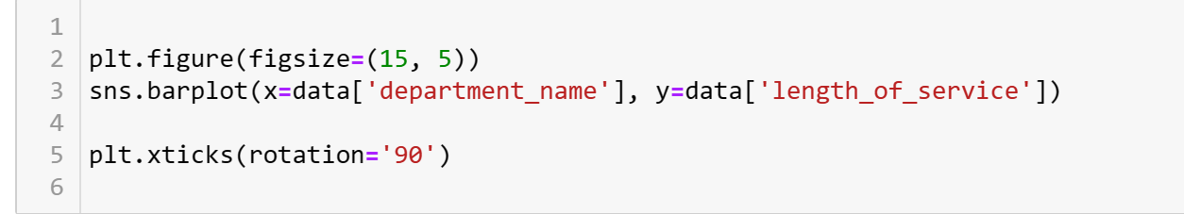
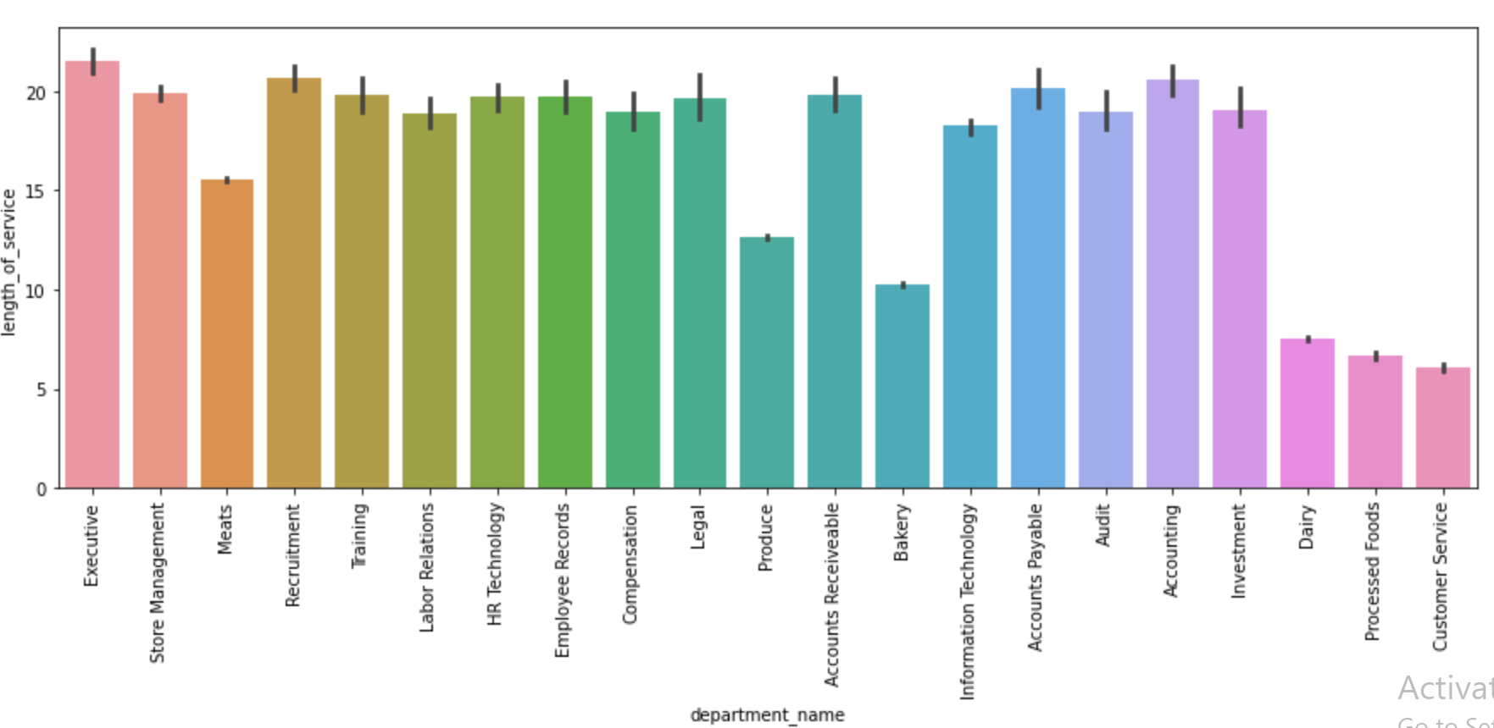
Bivariate Data Visualization
Categorical vs Numerical
Type and run to view the department name vs the length of service
Here the Black horizontal line is indicating huge differences in the length of service among different departments.
www.brainiacs.com.ng
Learn, Play, Innovate
Notes:
Here the Black horizontal line is indicating huge differences in the length of service among different departments.

Slide 25
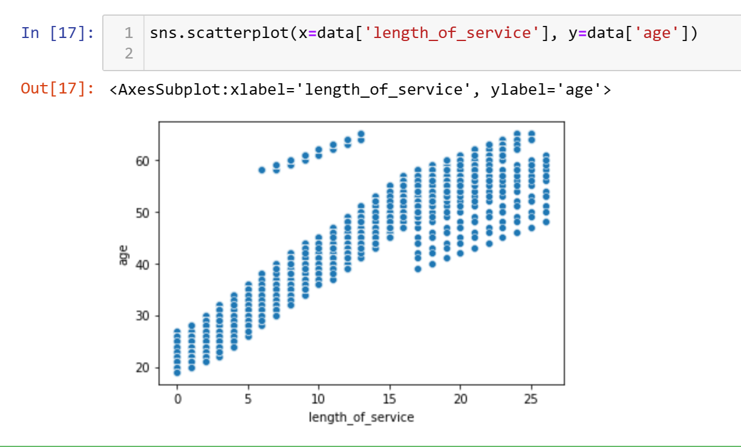
Bivariate Data Visualization
Numerical v/s Numerical
Type and run to view the age vs the length of service
It displays the age and length of service of employees in the organization as we can see that younger employees have less experience in terms of their length of service.
www.brainiacs.com.ng
Learn, Play, Innovate

Slide 26
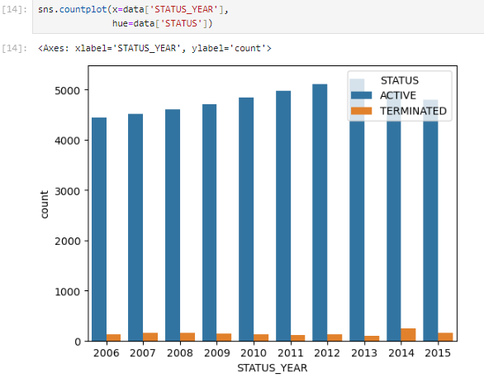
Bivariate Data Visualization
Categorical v/s Categorical
Type and run to view the count of the status year, we view this with respect to the status ACTIVE or TERMINATED
www.brainiacs.com.ng
Learn, Play, Innovate

Slide 27

Well-done!
www.brainiacs.com.ng
Learn, Play, Innovate

Slide 28
Contact Us
Phone No: +234 909 109 5057
Email: brainiacsng@gmail.com
info@brainiacs.com.ng
Website: www.brainiacs.com.ng
Google+: brainiacsng
Twitter: Brainiacs_Ng
Facebook: Brainiacs Nigeria
Youtube Channel: Brainiacs_Ng
www.brainiacs.com.ng
Learn, Play, Innovate

